Slide 1
MSDS 460 – Final Project
Optimization With Citibike Sharing Data
By
Gurjeet Singh
Sri Seshadri
Rupesh Kothari

Slide 2

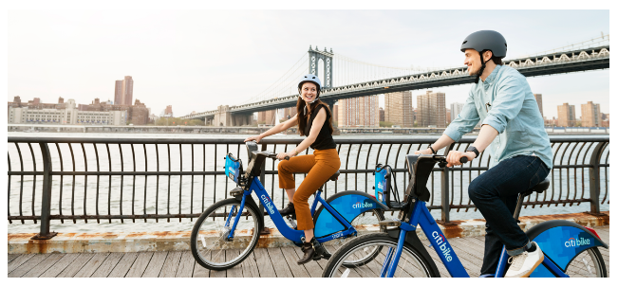
introduction
Nation’s largest bike share program
12,000 bikes
750 stations across NY & NJ
Program Benefits
Save time & money
Explore and get active
Go green
www.citibikenyc.com
Notes:
1. Nation's largest bike share program, with 12,000 bikes and 750 stations across Manhattan, Brooklyn, Queens and Jersey City.
2. Benefits
Save Money
Save Time
Get Exercise
Go Green
3. Talk about the motivation for studying it.
-- Current bike share company use their experience and last year’s data to rebalance bikes between stations
--- Our goal was to get something reasonable working so we can take the product to them…..

Slide 3
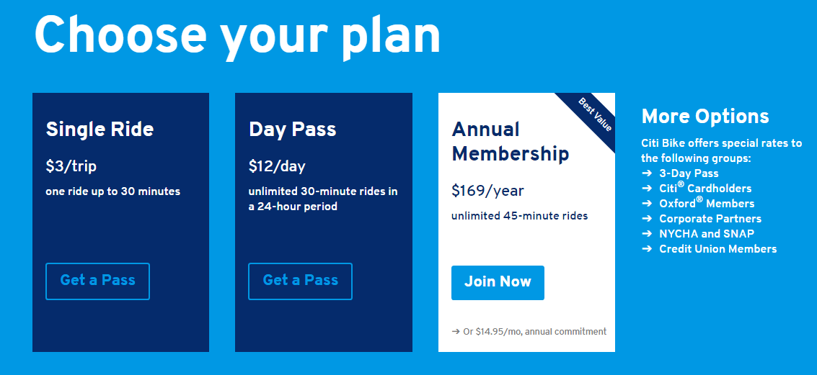
introduction
Notes:
Pricing Options
Single Ride
Day Pass
Annual Membership

Slide 4
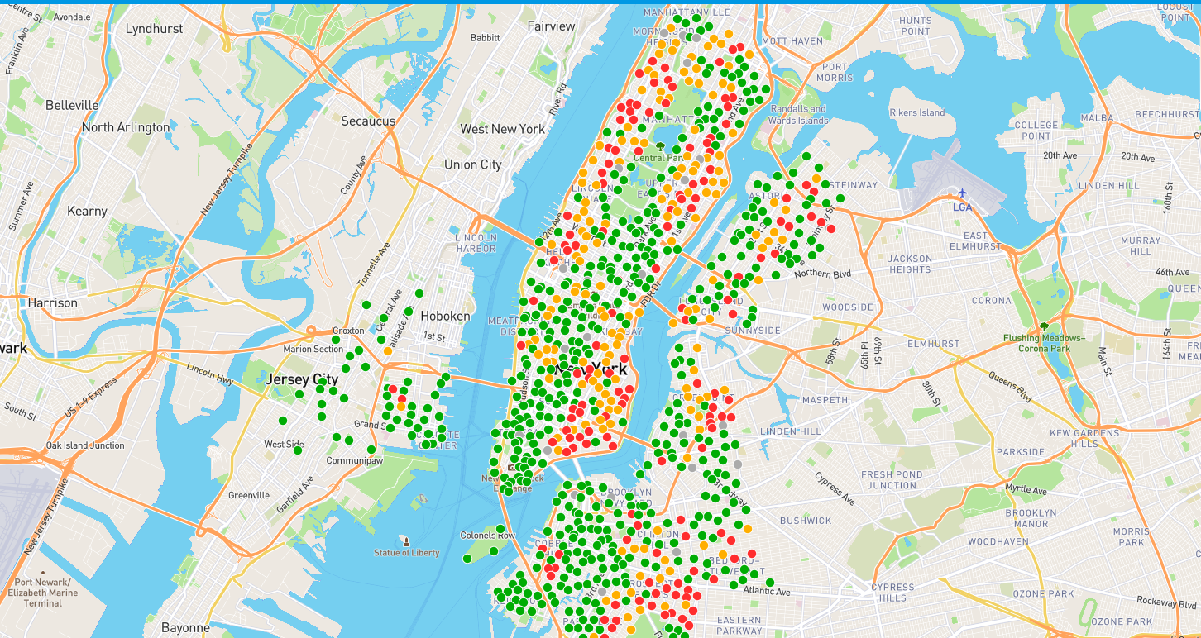
introduction
Notes:
Green – Bikes available
Yellow – Bikes are low – 1 or 2 left
Red – No bikes available.
Reason to display the graph to show how company might be losing money for not rebalancing the stations on time.

Slide 5
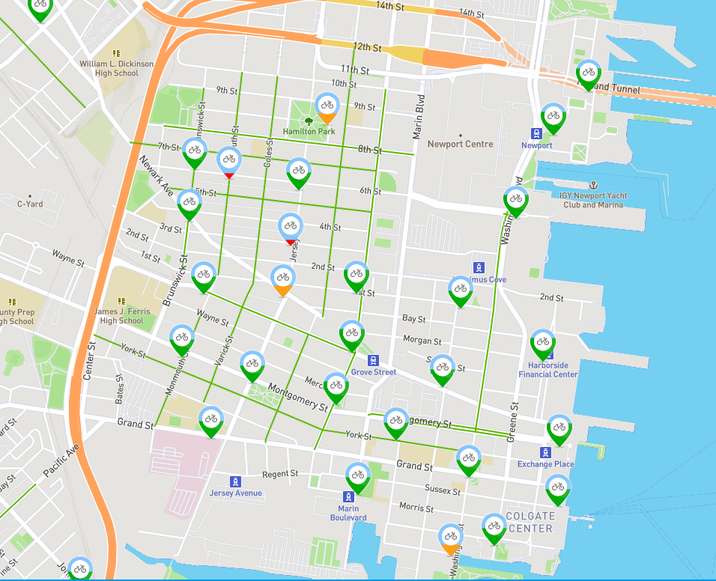
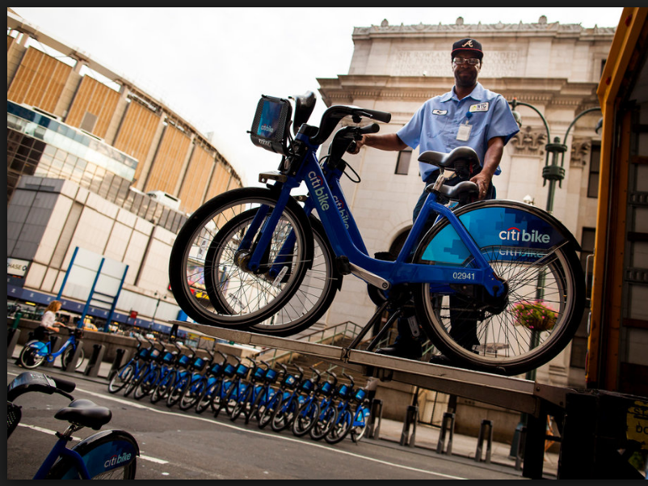
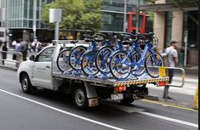
Objective
Notes:
Distribution of stations across the operating area
Picking the optimum number of bikes needed to maximize profitably
Picking the number of docks at each station to facilitate usage
Pre-balancing and Rebalancing
Biggest challenge
Expensive
Resource Intensive
Difficult to implement successfully during the day
We will try to tackle the hardest challenge for the bike operators
Optimization problem is to produce series of truck routes to get system balanced
Overnight (Pre-Balancing)
Low traffic
Resulting trip times are reliable and short
During the day (Rebalancing)
High traffic
Motivates the use of bike trailers instead of trucks to allow easy move through the city
End goal is not to maintain system balance but ensure users are never far from bike or dock

Slide 6
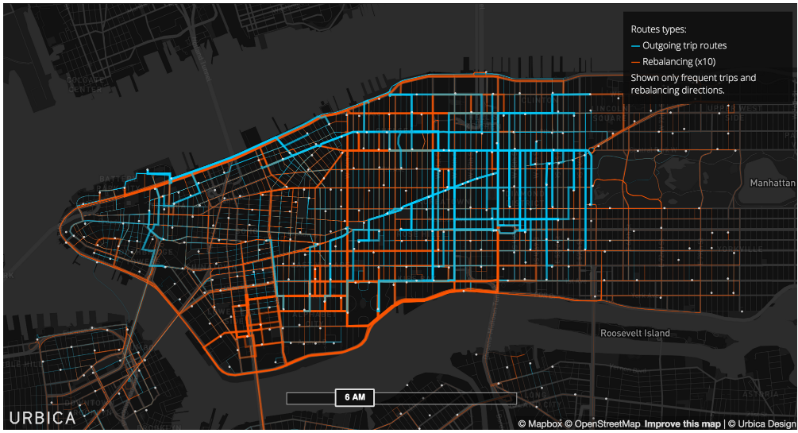
New York City bike Rebalancing
Notes:
Quick overview of the Citibike rebalancing process in Manhattan.

Slide 7
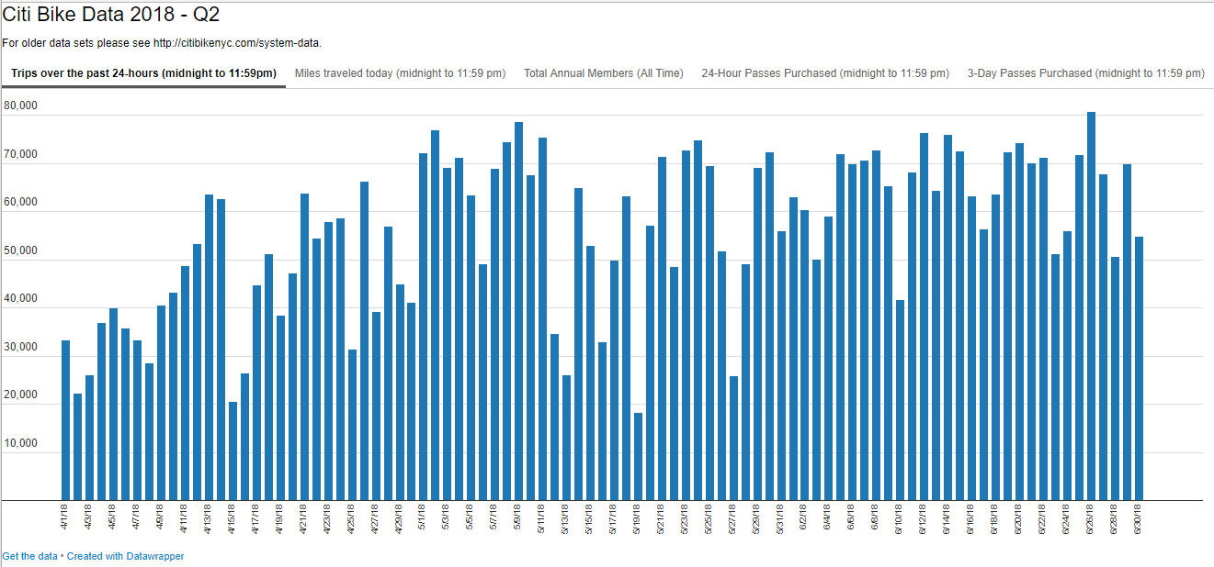
Data Exploration
Notes:
Explored Q2 data: Total number of trips in a given day – Between April1 – June 30th.

Slide 8
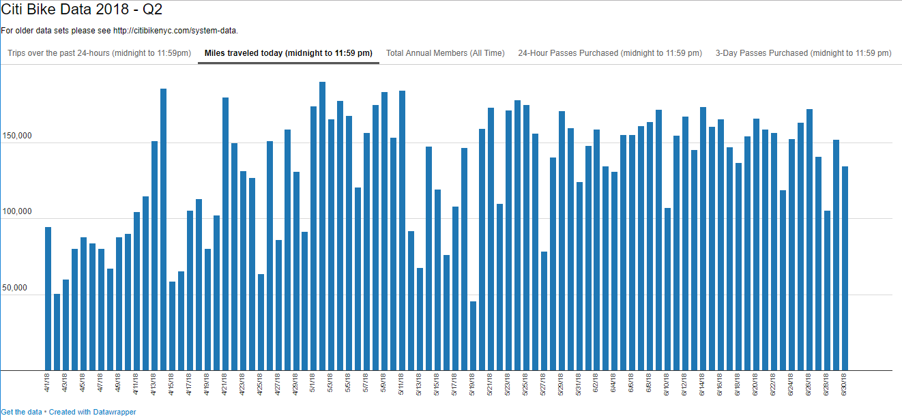
Data Exploration
Notes:
Total miles driven per day for Q2

Slide 9
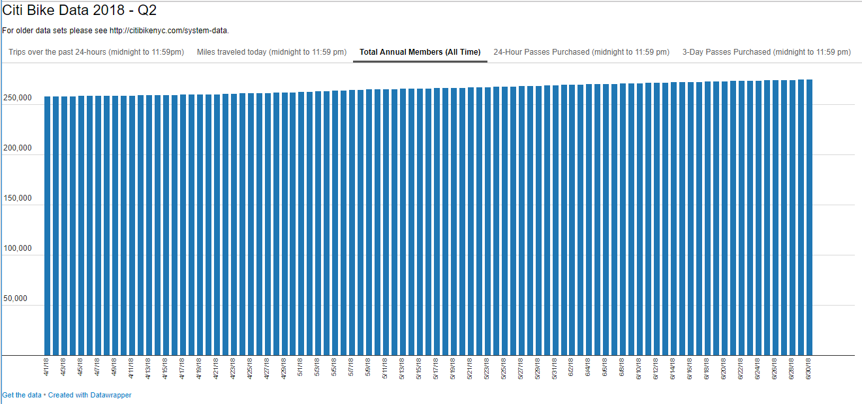
Data Exploration
Notes:
Positive growth; Members increasing. City bike has over 250K annual members

Slide 10
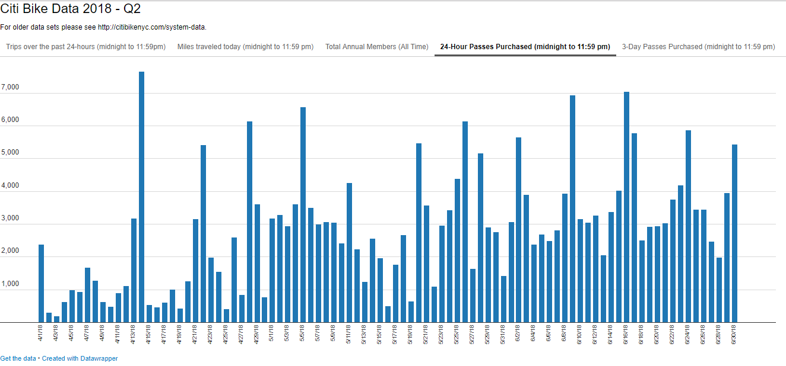
Data Exploration
Notes:
As the summer approaching, people are buying more daily passes. This could be due to the inflow of tourist in the New York. Some of the dips we notice in May and June could be due to the bad weather, etc.

Slide 11
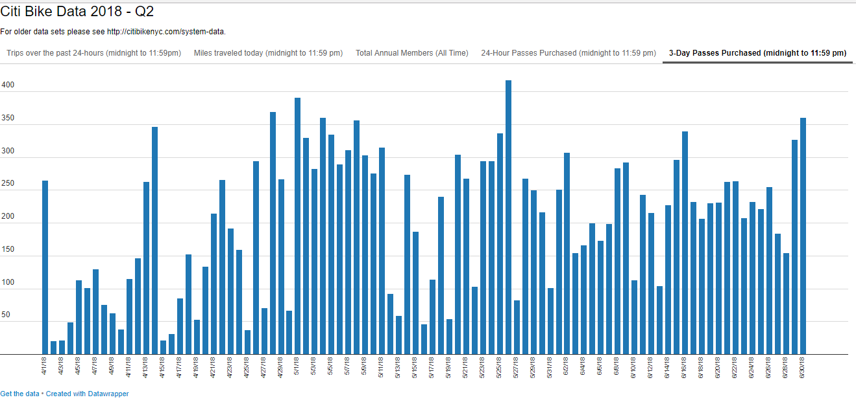
Data Exploration
Notes:
Activity of 3-day passes members per day

Slide 12
Data Exploration
Data Provided by CitiBike
Where do Citi Bikers ride?
When do they ride?
How far do they go?
Which stations are most popular?
What days of the week are most rides taken on?
Who are the Bikers to some extent?
Notes:
With the help of actual data, we were able to determine the flow of the bikes, distance, popular stations and the busy days – weekdays or weekends.

Slide 13
Challenges
To be added
Solver issues

Slide 14
Approach / Proposed methodologies
Vehicle routing problem (VRP) is a combinatorial optimization and integer programming problem
Generalization of Traveling salesman problem with multiple vehicles/bikes
Essential solving optimal set of routes for a fleet of vehicles to traverse in order to deliver to bikes to meet the demand at all stations while picking bikes from stations that have excess capacity
Capacitated Vehicle Routing Problems (CVRP), where the vehicles have constraints on their maximum loads is what we use for our problem

Slide 15
Assumptions
We use a sample of bike stations for our optimization exercise
Assumptions on costs to move bikes around the stations
Do cost to distance relationship- formulate
Assumptions on excess demand and excess capacity

Slide 16
Selected station map with demand

Slide 17
Model formulation
Constraints 1 and 2 state that exactly one arc enters and exactly one leaves each vertex associated with a customer, respectively.
Constraints 3 and 4 say that the number of vehicles leaving the depot is the same as the number entering
Constraints 5 are the capacity cut constraints, which impose that the routes must be connected and that the demand on each route must not exceed the vehicle capacity
Constraints 6 are the integrality constraints

Slide 18
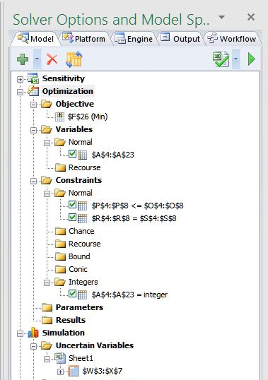
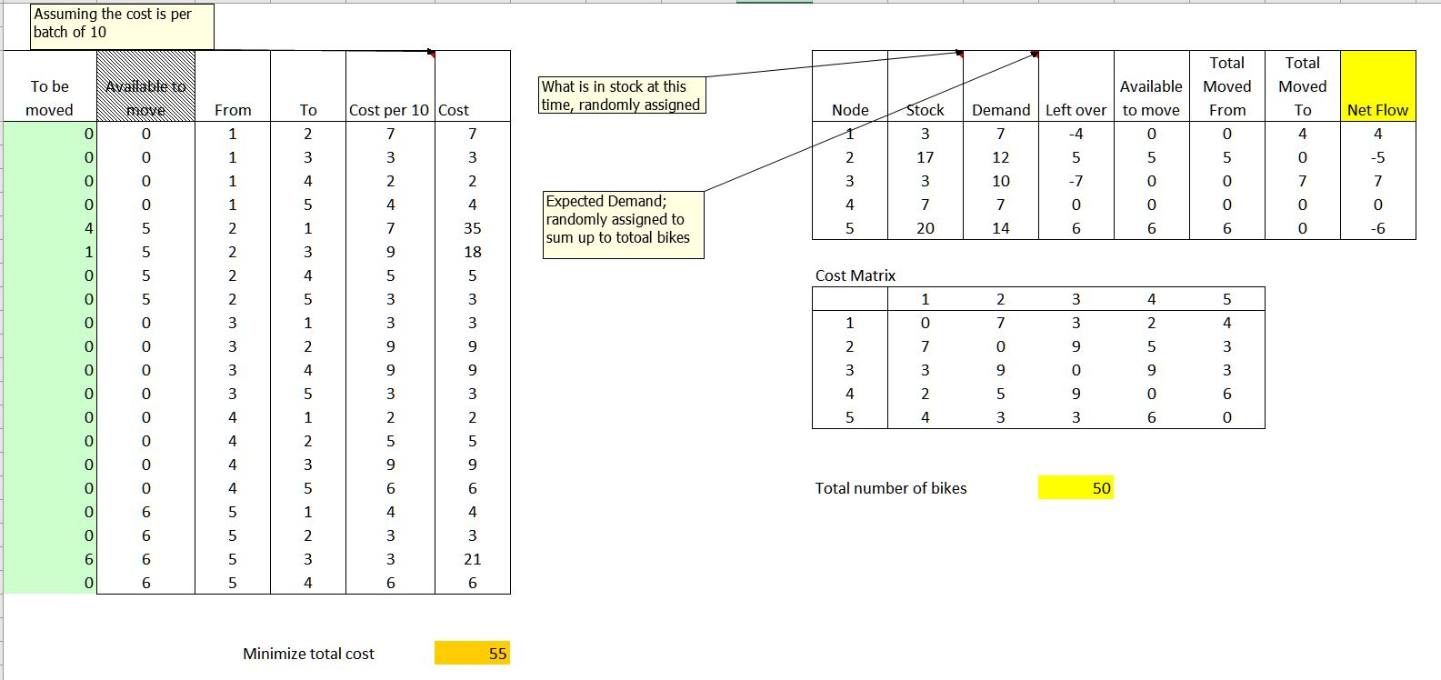
Excel Solver - Setup

Slide 19
Limitation of solver approach
The model as is would take lot of time to be solved.
The excel based model was not conducive for supplying various demand scenarios for re-balancing.
The decision variable cannot be a function of a RNG in ASPE

Slide 20
Model choices
Vehicle Routing Problem –
Pick up and Delivery with Capacity constraints.
Fixed capacity for vehicle.
Consignment has specific pick up and drop off points
Pick up and Delivery with Time window constraints.
Same as above
Includes constraints for when consignment is picked up and delivered
FedEx, UPS, Uber, Lyft
Capacity Constraint only.
Ideal for our use case.
Do not need specific drop off location for any particular bike.
Number of bikes in truck is made >= 0 as a constraint, for solution to work.

Slide 21
model formulation-Python

Slide 22
VRP - Capacity constraint
The model needs a seed of possible solutions to be further optimized
Heuristic approach
Constraints programming
Further optimize the model using Mixed Integer Programming.
Reference :
Dumitrescu, S. Ropke, J.-F. Cordeau, and G. Laporte, “The traveling salesman problem with pickup and delivery: polyhedral results and a branch-and-cut algorithm,” Math. Program., vol. 121, no. 2, p. 269, Jul. 2008.
R. J. O’Neil and K. Hoﬀman, “Exact Methods for Solving Traveling Salesman Problems with Pickup and Delivery in Real Time,” p. 30.
https://developers.google.com/optimization/

Slide 23
Results-python

Slide 24
conclusion

Slide 25
Future options
There are other variations of VRP that can be applied to our situation
Vehicle Routing Problem with Time Windows (VRPTW): The delivery locations have time windows within which the deliveries (or visits) must be made.
Vehicle Routing Problem with Multiple Trips (VRPMT): The vehicles can do more than one route.
Open Vehicle Routing Problem (OVRP): Vehicles are not required to return to the depot.

Slide 26
references

